Slide 1
Computational economics HW2 Shangze Dai

Slide 2
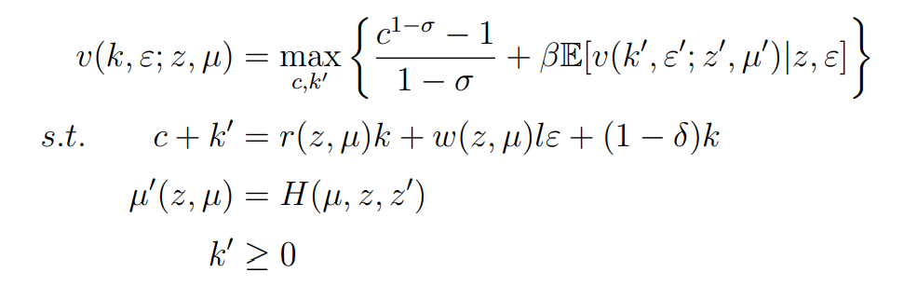
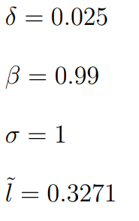




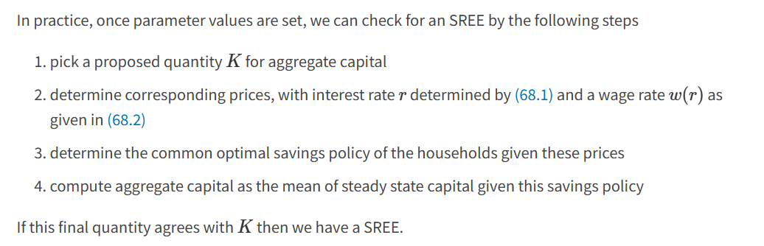
Question 1
Only bad case
Assumption: let labor normalized to 1
Note from QuantEcon.org:

Slide 3

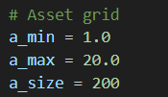

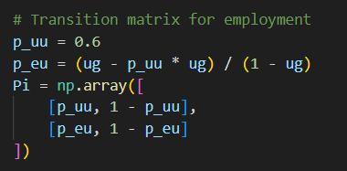
Question 1
To solve the equilibrium, we:
Get the equilibrium K using iteration. (initial guess: 20)
Get r and w through production function.
Then, we can have everything we need for iteration and solve for equilibrium.
PS (1) To discrete the possible wealth; (2) To define a Markov chain for the dynamic between employed and unemployed.
As shown in handout

Slide 4
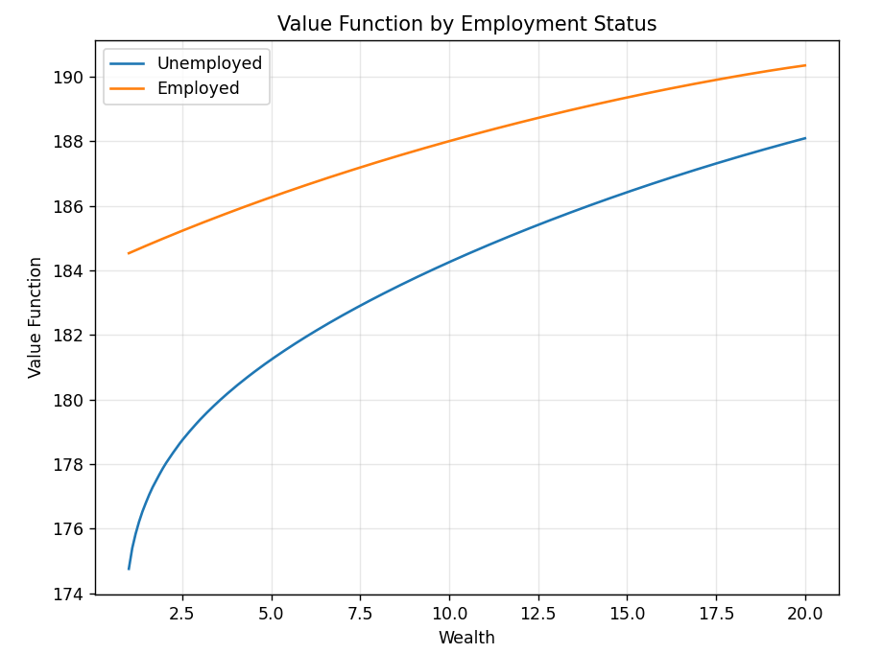
Wealth and PV of Utility

Slide 5
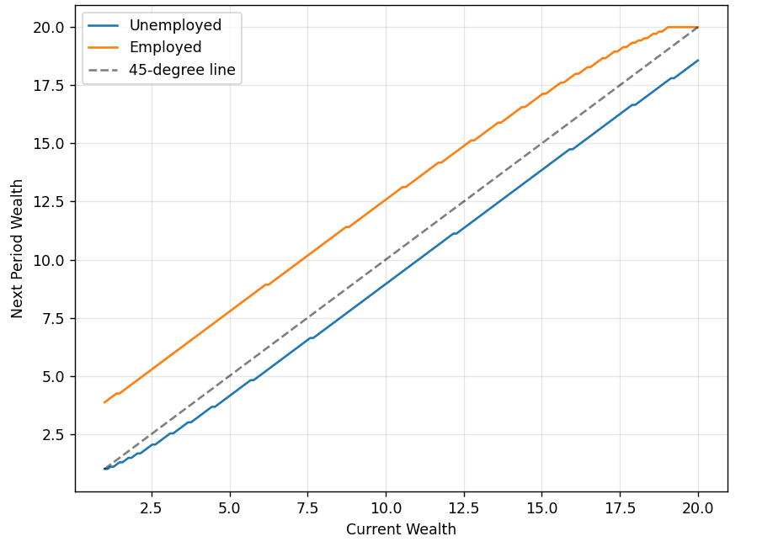
Money today and money tomorrow
In equilibrium, 45 should be hold. (unchange)

Slide 6
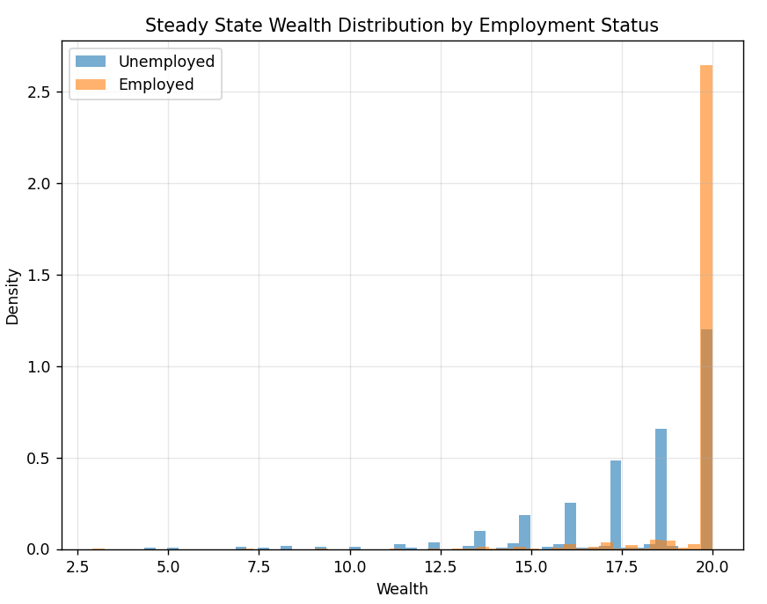

Parallelization can sometimes slow down the code due to overheads like thread creation, synchronization, or inefficient memory access patterns. In this case, the slowdown likely occurs because:
Small Grid Size: With a_size=200, each parallel task is too lightweight, making thread management overhead dominate the actual computation.
Shared Memory Contention: Multiple threads writing to V_new may cause cache conflicts or false sharing.
Compiler Optimizations: Numba’s serial code might benefit more from aggressive vectorization, while parallelization can inhibit these optimizations.

Slide 7
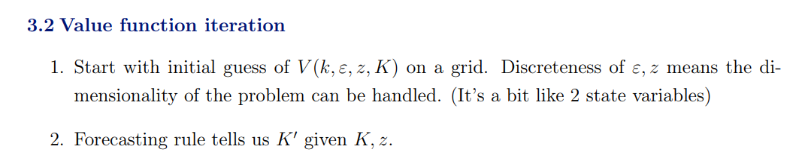
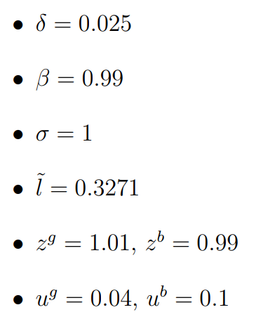
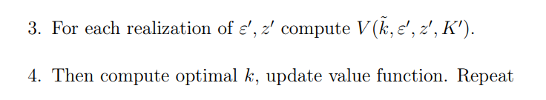
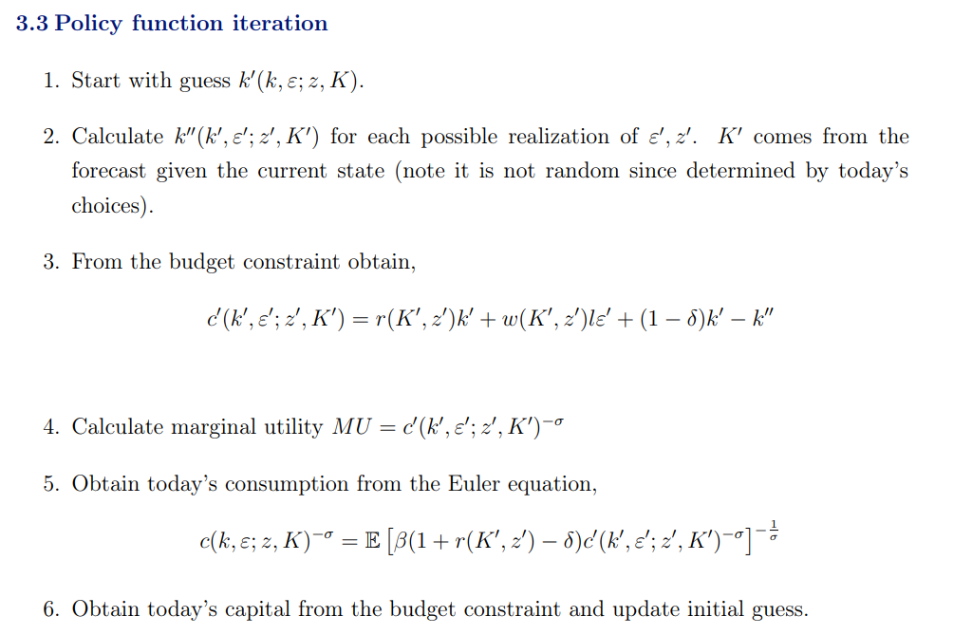
Now we have both good and bad cases:
K is changing.

Slide 8
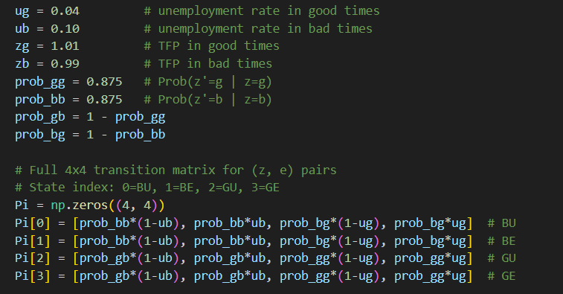

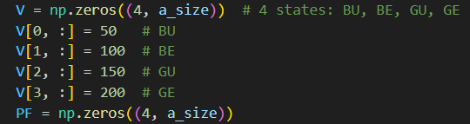
Transforming
Matrix
Initial Capital: 40
Why 40: larger R^2
Initial Guess
Value function
Policy function:
No saving

Slide 9
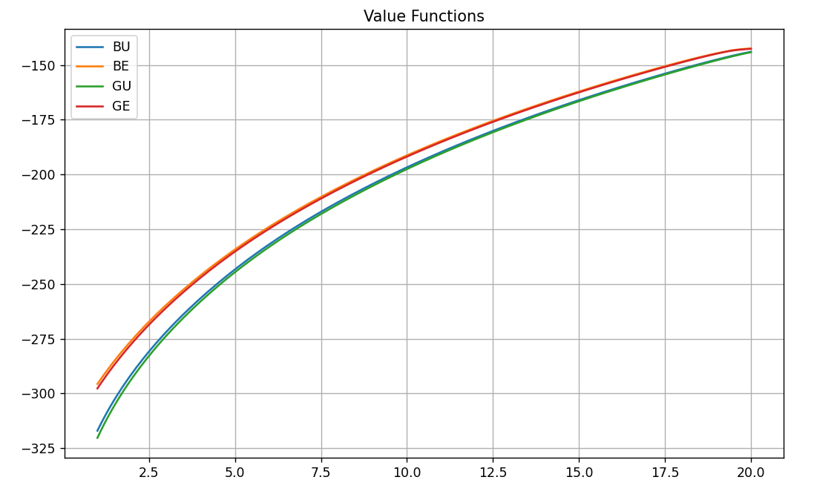
Wealth and PV of Utility

Slide 10
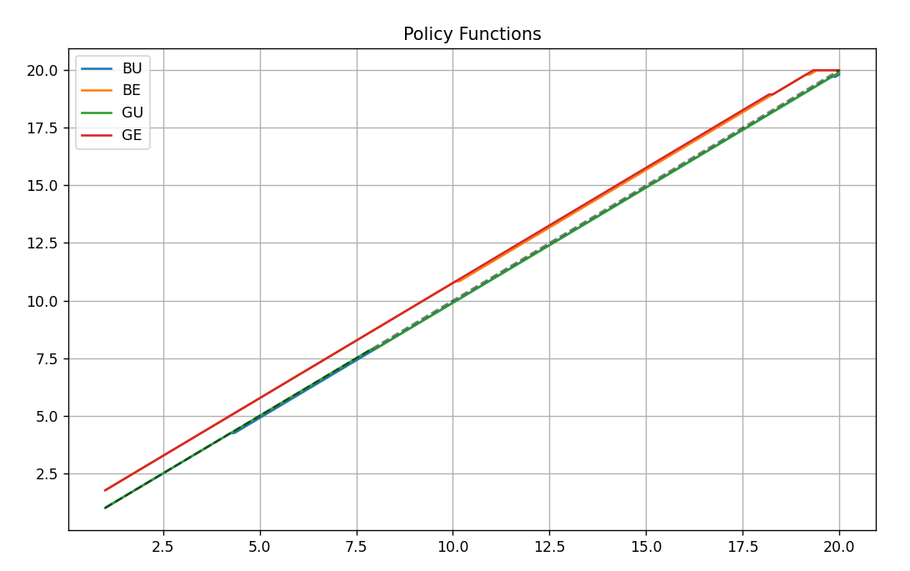

Slide 11
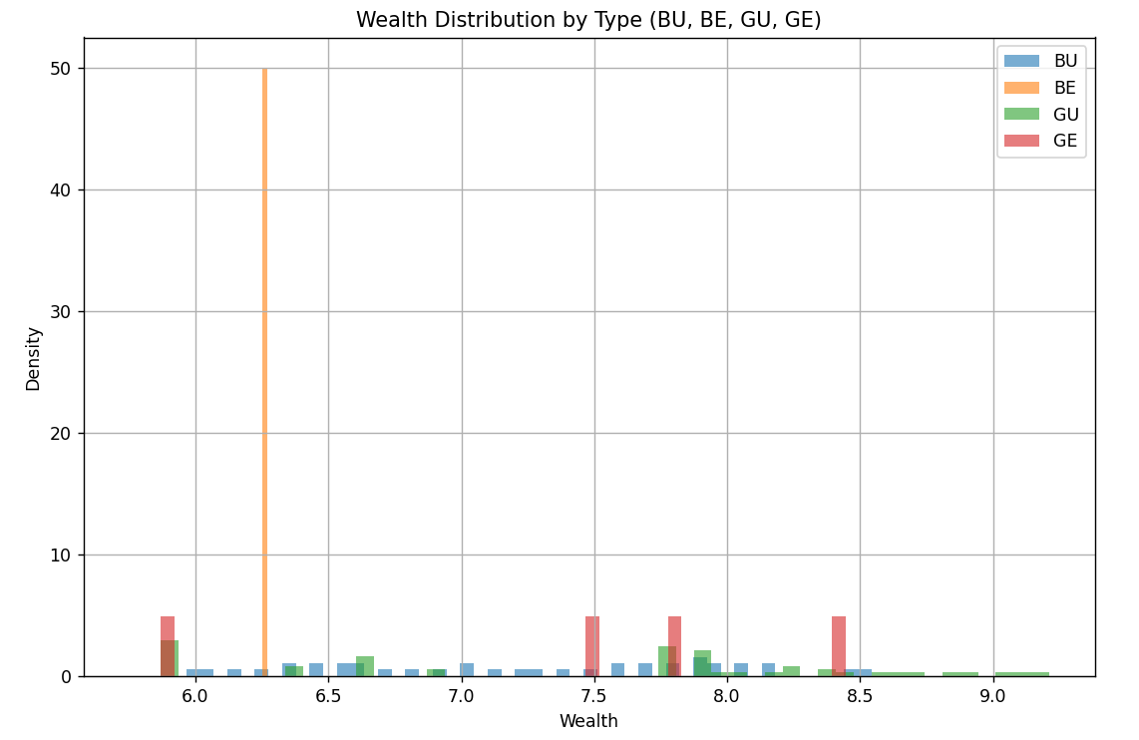

Slide 12
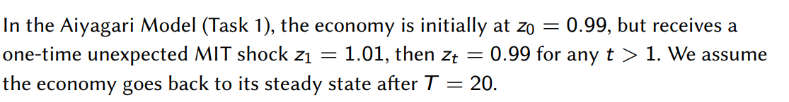
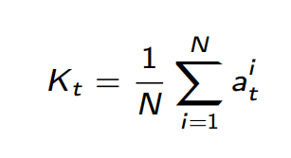
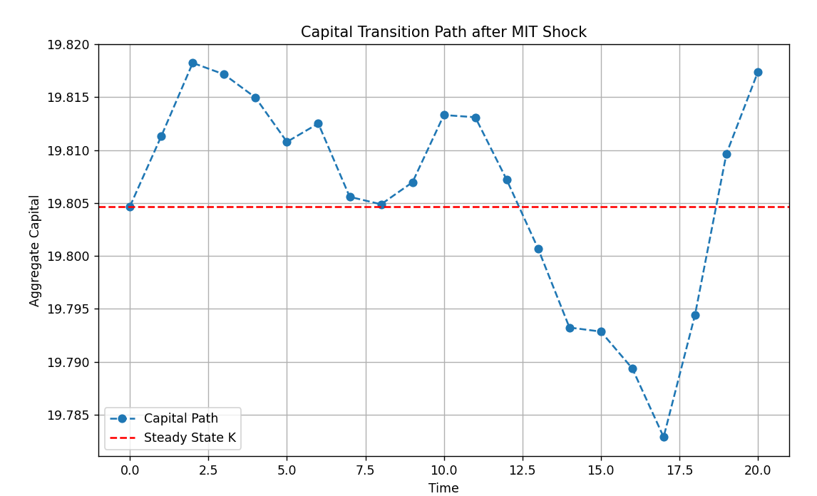
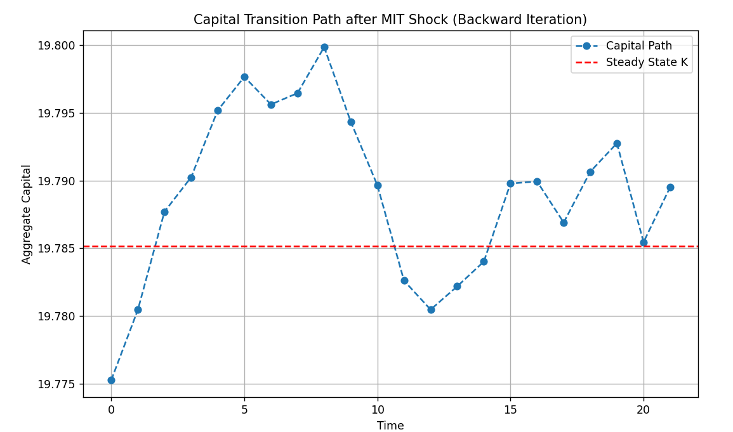
Optimal policy and value function in 1.01 and 0.99

Slide 13
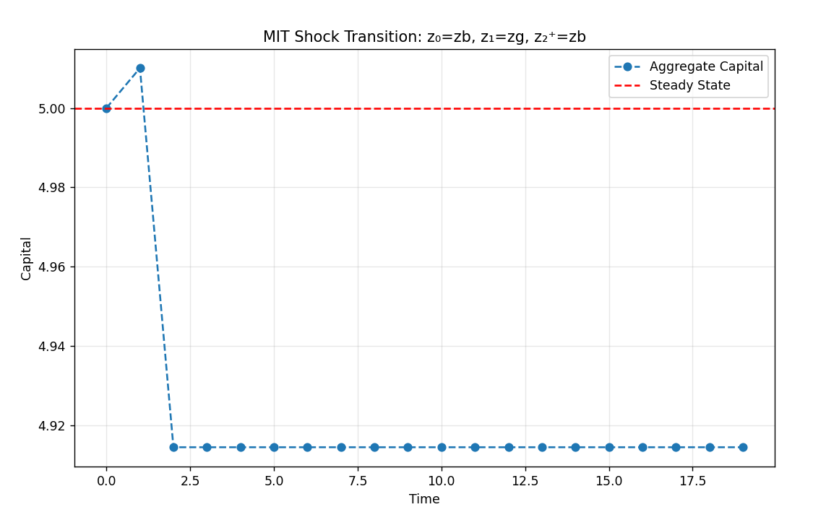

Slide 14
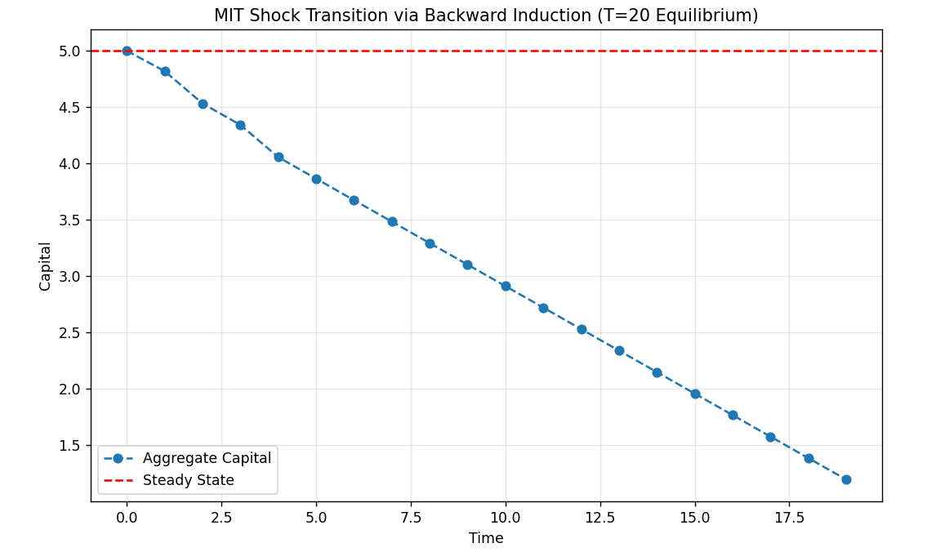
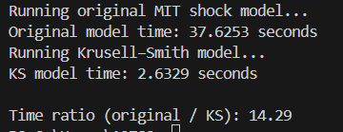
Why fast and picture like that? Because the path for K has been set already

Slide 15
THANK YOU

